Slide 1
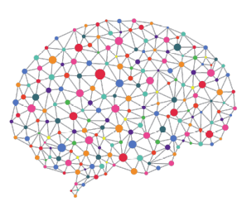


Cancer Classification using Deep Learning on Matched Biopsy Images and RNA-Seq
One Year Confirmation Seminar
Peter Donnelly
9 November 2020
peter.donnelly@petermac.org

Slide 2
Agenda
Clinical Context, Hypothesis, Aims, Objectives
Automated Classifiers
How they work
How to evaluate classifier performance
Progress
Classifier developed over the past 12 months (Aim 1)
Results of preliminary experiments: classifying stomach cancer
The Next 18 months
Testing the hypothesis (Aim 2 and Aim 3)

Slide 3
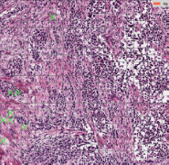
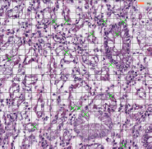
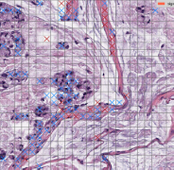
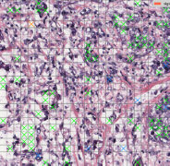
Clinical Motivation
Clinical Context
Cancers are still mainly detected and classified by inspection of biopsy tissue
but some are difficult or impossible to classify visually ...
… and two pathologists can classify the same sample differently
Classification determines treatment, so accurate classification matters
Automated Classification
Active area of research
The best classify ‘straightforward’ cancer subtypes very well
They use either images or RNA-Seq
Why not use both ?
Biopsy images of the four main Stomach Adenocarcinoma
cancer sub-types (classified by my classifier)
Diffuse
Tubular
Diffuse
Mucinous
Signet Ring

Slide 4
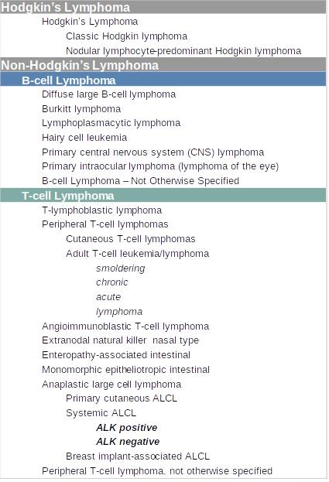

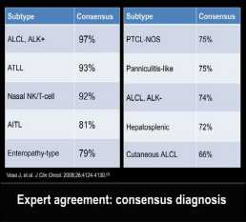
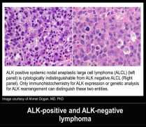
Lymphoma Classification
Pathologists find some T-Cell Lymphomas very difficult to classify
  ALK+ and ALK- are almost indistinguishable
  Treatment for each differs
  + sub-type has the better prognosis
A Pathologists Guide to the Accurate Diagnosis of Peripheral T-Cell Lymphoma

Slide 5
Hypothesis and Objective
Hypothesis
A classifier trained on BOTH images AND RNA-Seq will
classify any cancer,
classify challenging cancers,
better than existing image or RNA-Seq specific classifiers
Key Assumption
Image & RNA-Seq don’t embody completely
identical classification-relevant information
Project Objective
Develop such a classifier and show that it performs
better than existing classifiers
RNA-Seq
Image
Both Image data and RNA-Seq data contain information relevant to classification. This information is likely to overlap greatly but not completely

Slide 6
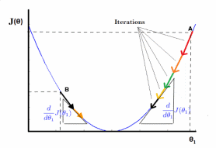

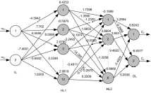

How it Works: Classifier Overview
Phase 1: Training (80% of examples)
Inputs
Process
Output
Examples labelled with classes
iteratively improve model weights
optimized model
Muc
Tub
Tub
Diff
Muc
Muc
Diff
Tub
Muc
Diff
Diff
Sig
Tub
Diff
Phase 2: Testing (20% of examples)
Inputs
Process
Outputs
unlabelled examples
push inputs through optimized model
labels
?
Diff

?
Muc

?
Muc


Slide 7
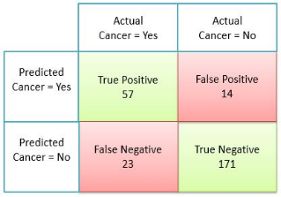
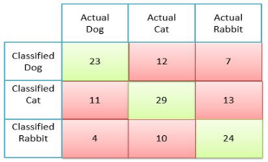
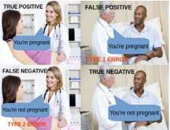
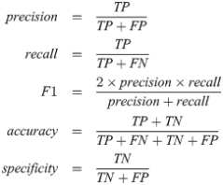
What Makes a Good Classifier?
Classifier effectiveness is evaluated with a Confusion Matrix
The confusion matrix below is for two classes ...
… but multi-class confusion matrices works identically
n=265
n=133
Demystifying Confusion Matrix and Performance Metrics in Machine Learning
All key statistics come directly from the Confusion Matrix
Understanding the Confusion Matrix

Slide 8
Aims
Aim 1 is by far the largest task
Aim 1 – Build Classifier
Develop a classifier capable of testing the hypothesis
Success criteria: demonstration of a classifier able to classify arbitray TCGA (i) image (ii) RNA-seq data (iii) matched data
Metrics: existence of classifier; validation testing
Aim 2 – Test the Hypothesis using TCGA Data
Success criterion: Classification performance better than any published paper classifying the same TCGA dataset
Metrics: Accuracy, Precision, Recall, F1, AUC
Aim 3 – Test the Hypothesis using PMCC TCL Data
Success criterion: Classification performance equal to an experienced human Pathologist as documented in appropriate published paper(s) or validated by PMCC Oncologist
Metrics: determined by the metrics used in the selected paper(s)
Progress
95%
10
%
5
%

Slide 9


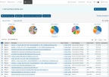



Aim 1: Build the Experiment System
Status: 95% complete. Able to subtype cancers using either Images or RNA-seq data
Fetch Raw Data
Pre-process Raw Data
Realize Optimum Model
Classify
Analyse Results
break
images
into tiles
remove background & degenerate
tiles
normalize
Colors
Image Branch
tiles
patches
Numerical normalization
TCGA
Extract
RNA-Seq
data
Reduce dimens-
ionality
resolve
gene
names
RNA Branch
RNA-Seq
‘End-to-end’ system. The classification sub-system is just the piece inside the arrowhead graphic
The (otherwise labour intensive and error prone) data acqusition and pre-processing aspects are largely automated
Able to dispatch & run multiple experminent jobs without user intervention
Produces scalar and graphical results in real-time
Based on the Pytorch machine learning library
Hardware: 16 x 3.5GHz core CPU, 132GB RAM; dual Nvidia Titan GPUs each with 576 tensor cores and 24GB memory

Slide 10


Aim 1: Preliminary Experiment: Sub-typing Stomach Cancer
Scope
Use system to classify TCGA Adenocarcinoma samples into the six TCGA defined subtypes
Image and RNA-Seq separately (can’t yet do matched Image and RNA-Seq)
Purpose
Validate the experiment system and classifiers
Establish a baseline for matched (Image+RNA-Seq) classification experiments
Parameters: Whole Slide Image Model
228 TCGA STAD H&E stained tissue samples
Each sample = 2500 randomly selected 64x64 pixel tiles
80% training set + 20% held-out
5,000 randomly chosen held-out tiles tested after each run, yielding 20,000 total predictions
Neural Network: VGG11 = 11 layer convolutional network (relu + softmax activation); ADAM optimiser
20 epochs per run
Parameters: RNA-Seq Model
479 TCGA STAD mRNA + lnRNA samples
Each sample = vector comprising 60,483 Upper Quartile FPKM values (Frequency per kilobase per million reads mapped)
80% training + 20% held-out
All held-out samples tested after each run yielding 96 x 101 = 9,696 total predictions
Neural Network: 3 layer fully connected network (relu + softmax activation); ADAM optimiser
200 epochs per run

Slide 11
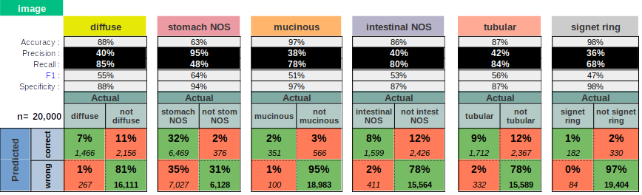
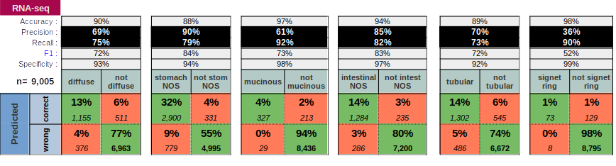
Aim 1: Preliminary Experiment: Results
Classification of 20% held-out examples for Stomach Cancer: 4 runs (Images); 101 runs RNA-Seq

Slide 12
Aim 1: Preliminary Experiment: Observations and Conclusions
Observations
Results look quite good (Accuracy), but this is superficial (Precision, Recall)
  Accuracy: 80-90%-ish for both Image and RNA-Seq
  Precision: 36-95% for image and 36-90% for RNA-Seq
  Recall: 48-85% for image and 73-92% for RNA-Seq
RNA-Seq model performed better and more consisently than Image model
Performance vared greatly between subtype, probably indicating some are easier to classify than others
Conclusions
The system is validated (Aim 1 Objective)
Results are typical of what others achieve with single mode classifiers
We have a benchmark to used when testing the hypothesis (Aim 1 Objective)

Slide 13
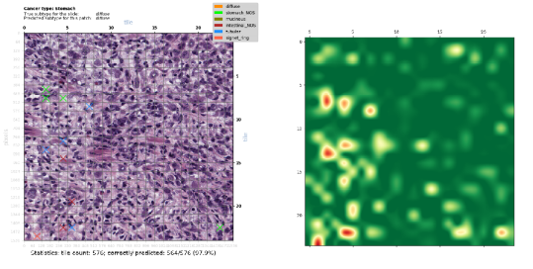
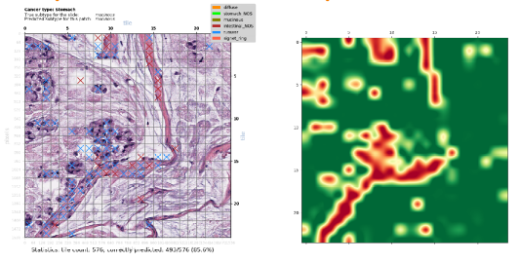
Aim 1: Classification of Contiguous Patches: Many Tiles From Same Sample
Randomly selected 24x24 tile patches (576 tiles)
Cross (‘X’) colour shows misclassified tile subtype; heatmaps show tile-level prediction confidence p(0,1)
Highly Confident and
Correct Prediction of Diffuse Subtype
(564/576=97.9% of tiles)
Moderately Confident and Correct Prediction of Mucinous Subtype
(485/576=85.6% of tiles)

Slide 14
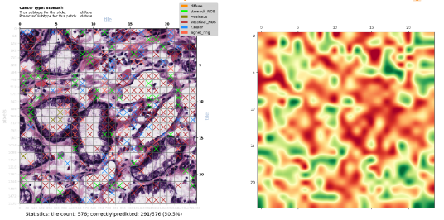
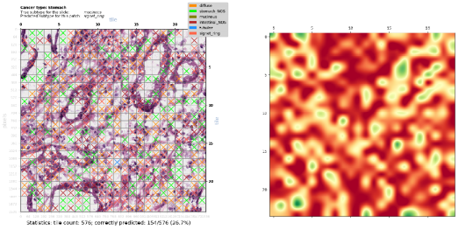
Aim 1: Classification of Contiguous Patches: Many Tiles From Same Sample
Randomly selected 24x24 tile patches (576 tiles)
Cross (‘X’) colour shows misclassified tile subtype; heatmaps show tile-level prediction confidence p(0,1)
Unconfident
but Correct Prediction of Diffuse Subtype
(291/576=50.5% of tiles)
Badly Wrong Prediction of Diffuse Subtype
as Signet Ring Subtype
(154/576=26.7% of tiles)
This is the worst misclassification of all 229 images

Slide 15
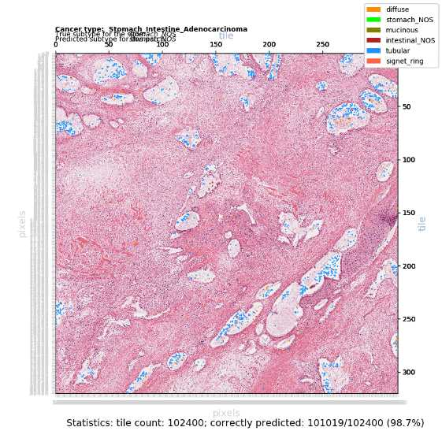
Aim 1: Classification of a Large Patch:
Patch of 320 x 320 = 102,400 tiles (420 mega-pixels)
The pink areas are correctly classified
The blue and orange areas are misclassified

Slide 16
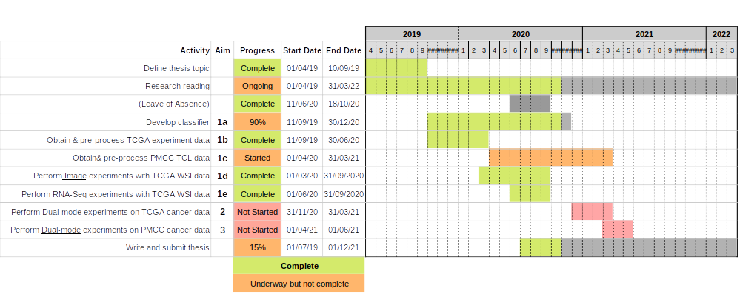
Bringing it All Together: The Next 18 Months
Complete Classifier (by Dec 2020)
Add support for matched samples (multimode)
Test the Hypothesis
Using TCGA data (by 31-03-21)
Using PMCC Lymphoma data (by 31-06-21)
Complete & Submit Thesis

Slide 17
Acknowledgements

